Slide 1
CRM SALES OPPORTUNITIES ANALYSIS
Analyzing Sales Pipeline Performance and Driving Data-Informed Decisions
By Ebunoluwa Nofiu

Slide 2
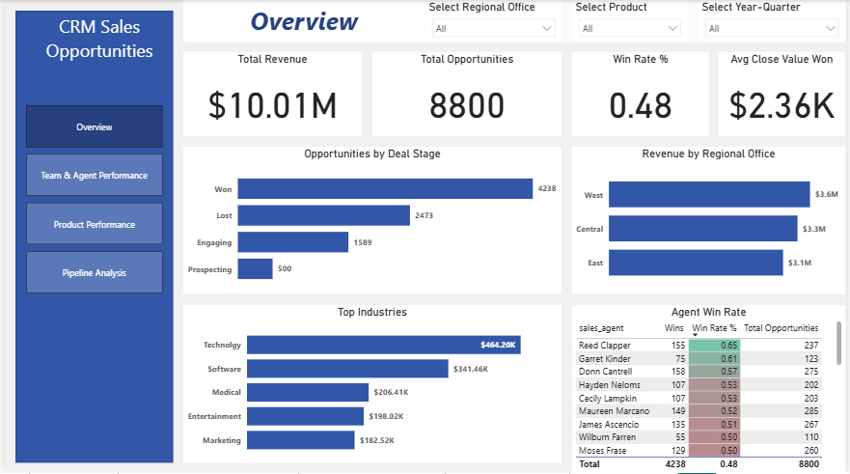
DASHBOARD OVERVIEW

Slide 3
INTRODUCTION
This project focuses on evaluating CRM sales opportunities data to determine how various sales teams, agents, and products perform across the organization’s sales pipeline. The goal is to determine the main drivers of revenue, identify where deals are being lost, and highlight opportunities to improve performance.
This project delivers insights into revenue, win rate, and deal stage trends, allowing management to make smarter, data-driven decisions to improve conversion rates, reinforce team performance, and boost overall sales efficiency.

Slide 4
OBJECTIVES
Evaluate overall sales performance and revenue drivers.
Assess sales team and agent effectiveness.
Analyze product and industry contributions to revenue.

Slide 5
PROBLEM STATEMENT
Sales leadership lacks visibility into team performance, product/industry revenue drivers, and deal losses across the pipeline.
This gap makes it difficult to optimize strategy, allocate resources effectively, and maximize revenue.

Slide 6
BUSINESS QUESTIONS
Which sales team is generating the highest revenue?
Which sales agent has the best win rate?
How has total revenue changed from quarter to quarter?
Which product generates the most revenue?
At what stage of the sales process are the most deals lost?

Slide 7
DATASET OVERVIEW
Source: Maven Analytics CRM Sales Opportunities.
Structure: 4 tables – Accounts, Products, Sales Teams, Sales Pipeline.
Star schema with Sales Pipeline as the fact table.
Stats: 8,800 opportunities analyzed.

Slide 8
ANALYSIS AND FINDINGS
KEY PERFORMANCE INDICATORS (KPIs):
Total Opportunities: 8,800 opportunities were recorded in the dataset.
Total Revenue: $10.01M was generated from all deals.
Total Wins: 4,238 deals were successfully closed.
Win Rate %: 48% of opportunities resulted in a win.
Average Deal Value (Won): $2,360 per closed deal.

Slide 9
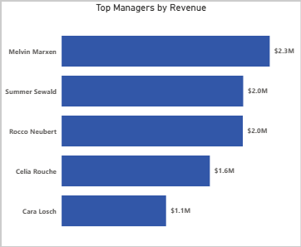
Which sales team is generating the highest revenue?
Melvin Marxen’s team outperformed other teams.
This shows strong sales leadership and execution, setting the team as a performance standard.

Slide 10
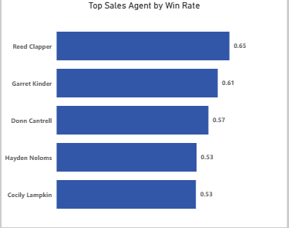
Which sales agent has the best win rate?
Reed Clapper had the highest win rate, while Lajuana Vencill had the lowest.
The gap draws attention to inconsistent agent performance.

Slide 11
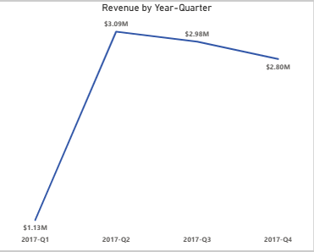
How has total revenue changed from quarter to quarter?
Revenue peaked in Q2 2017, and declined slightly in subsequent quarters.
This pattern indicates that growth pace has slowed, indicating circumstances need to be reviewed.

Slide 12
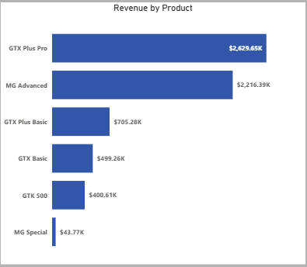
Which product generates the most revenue?
GTX Plus Pro had the highest product revenue, while MG Special did poorly.
The results support GTX Plus Pro’s status as a primary source of income, while MG Special may need a review of strategy.

Slide 13
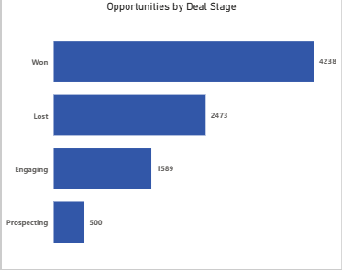
At what stage of the sales process are the most deals lost?
The “Lost” stage still accounts for the majority of deals.
This points to significant hindrances in deal closure, emphasizing the need for better sales strategies.

Slide 14
RECOMMENDATIONS
Focus on top-performing agents like Reed Clapper and their teams in order to spread great practices throughout the organization.
Provide agents who are having troubles converting, with specific training that targets the holes identified by the pipeline analysis.
Invest in high-revenue drivers like GTX Plus Pro and reposition or promote underperforming products like MG Special.
Implement CRM alerts and follow-up processes to discover stalled deals early and reduce late-stage losses.
Leverage growth in high-performing industries, such as Retail, while investigating untapped potential in lagging ones.
Track quarterly revenue and win rate trends to make proactive strategy adjustments and sustain steady pipeline growth.

Slide 15
CONCLUSION
This analysis shows that despite strength in revenue growth, success varies by teams, products, and regions. By enhancing the strengths of top performers, resolving late-stage deal losses, and improving product strategy, the organization can increase win rates and promote more steady, sustainable growth.

